Slide 1
Optic disc characterization in myopic eyes
March 11, 2020

Slide 2
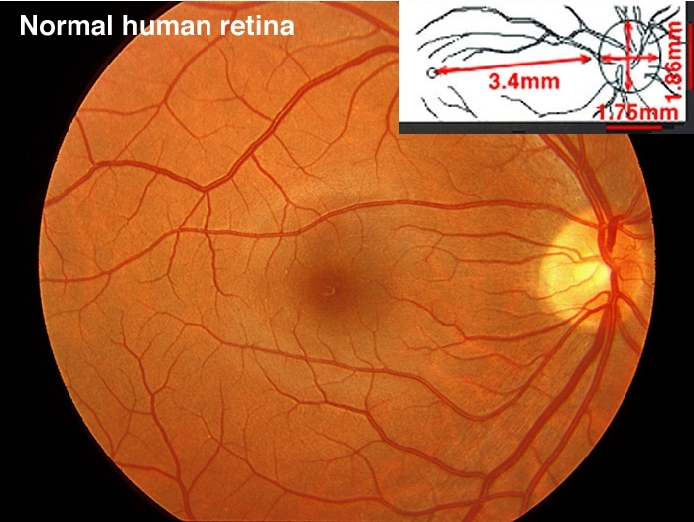
Normal Optic Nerve Head
Expected changes in myopia
Central retinal changes
Disc related changes
Peripheral changes
Optic nerve head / Disc
Fovea

Slide 3
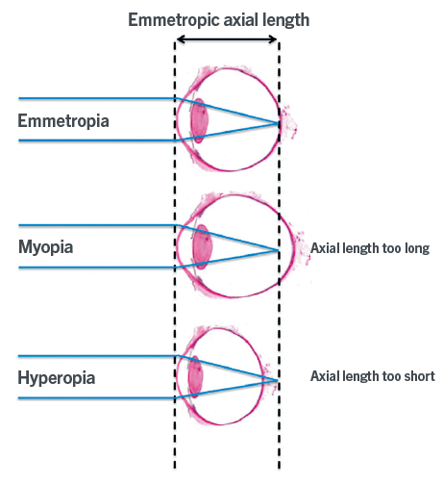
Myopic Eye

Slide 4
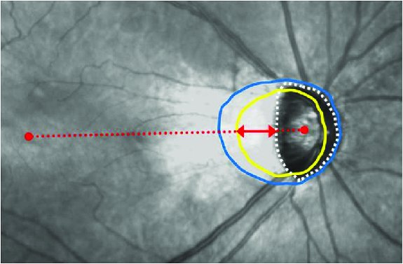
Optic nerve head characterisation in myopia
With increasing axial length
Changes in shape from an almost circular one to a vertically oval structure¹
Parapapillary gamma zone develops and enlarges at the temporal disc border²⁻⁵
The width of gamma zone corresponded to the amount of overhanging of Bruch membrane (BM) into the intrapapillary compartment at the nasal disc side⁶
It suggested that the development of gamma zone in medium myopic eyes was because of a shift of the Bruch membrane opening (BMO) in the direction to the macula
doi:10.1371/journal.pone.0170733.g001
White dotted line: optic disc margin
Yellow dotted line: BMO
Blue dotted line: Beta zone PPA margin
Distance of red line:
Red arrow: The BM opening
Red dotted line: The width of the temporal PPA without BM (gamma zone)

Slide 5
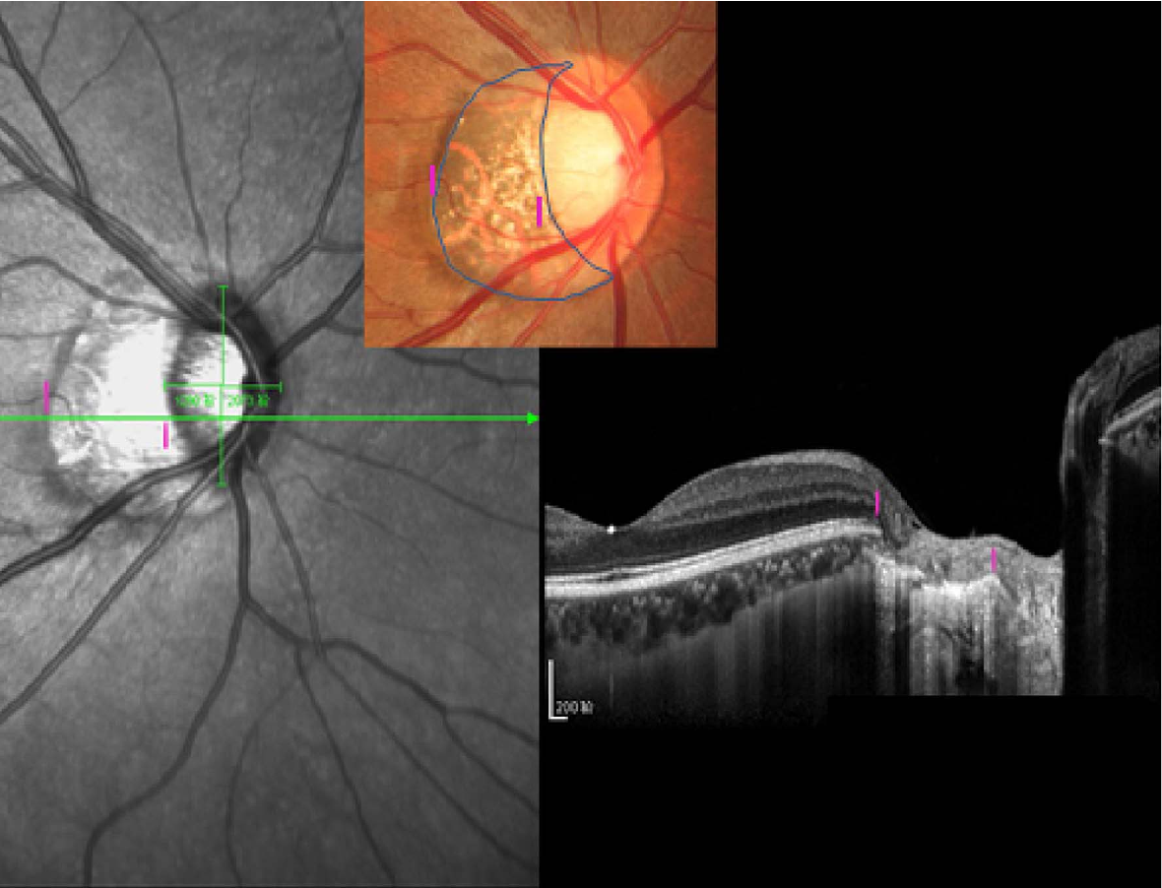
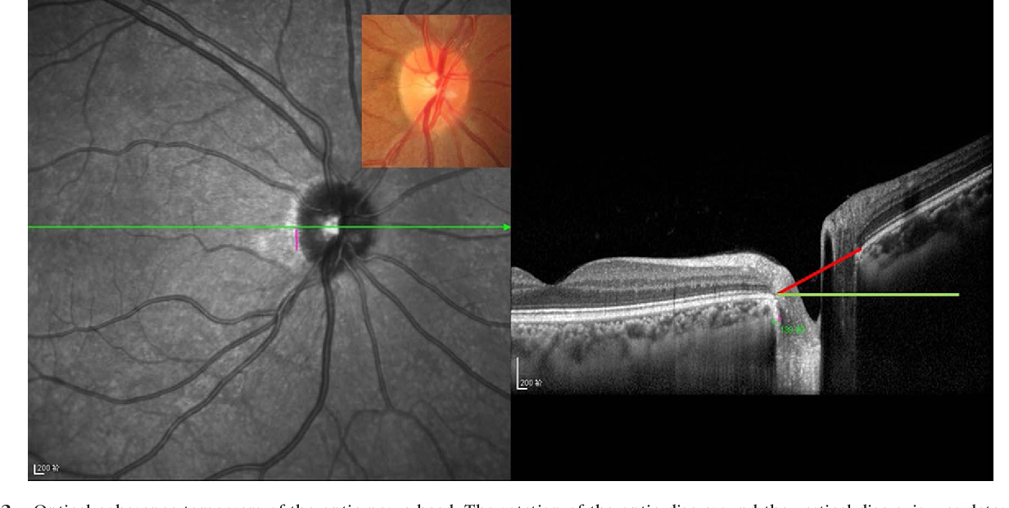
Optic Nerve head tilt

Slide 6
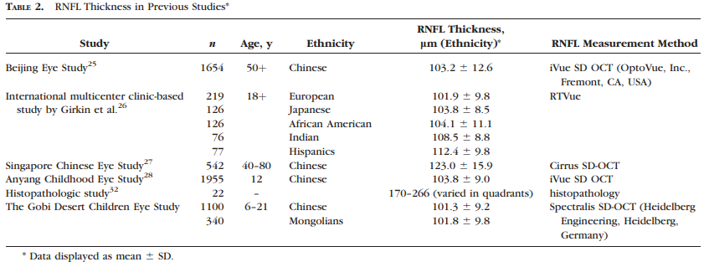
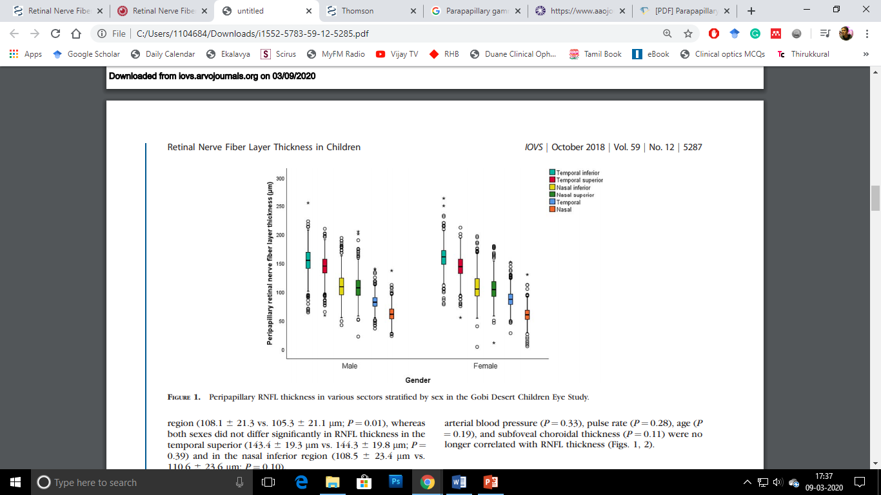
Wang CY et al, 2018
The overall RNLFT significantly decreased with higher myopic refractive error and male sex
Peripapillary RNFL thickness in various sectors stratified by sex in the Gobi Desert Children Eye Study

Slide 7
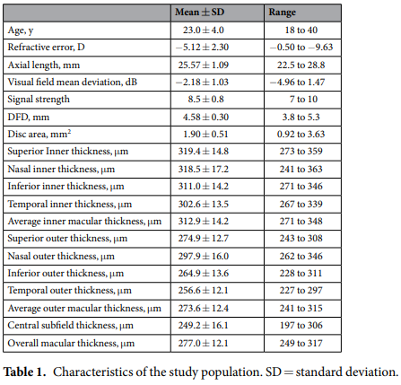
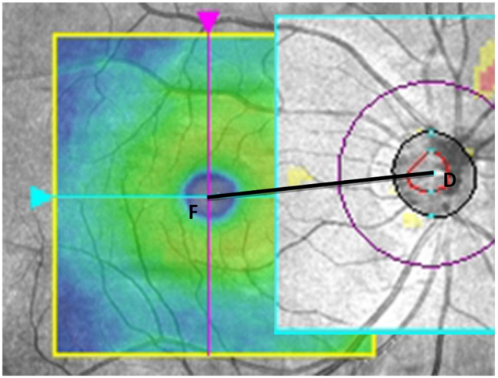
Influence of optic disc-fovea distance on macular thickness measurements with OCT in healthy myopic eyes

Slide 8
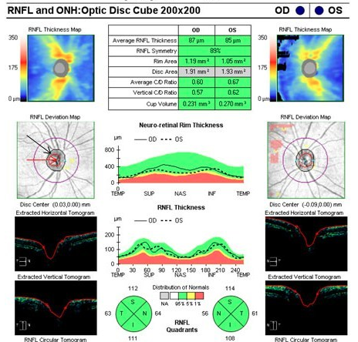
Proposed study…..
Guo Y at al., 2018 investigated the parapapillary gamma zone and optic disc dimensions and shape were measured on fundus photographs.
Can we quantify the parapapillary gamma zone and optic disc dimensions using SD-OCT images?
Most of the optic disc dimensions are measured by the inbuilt algorithm

Slide 9
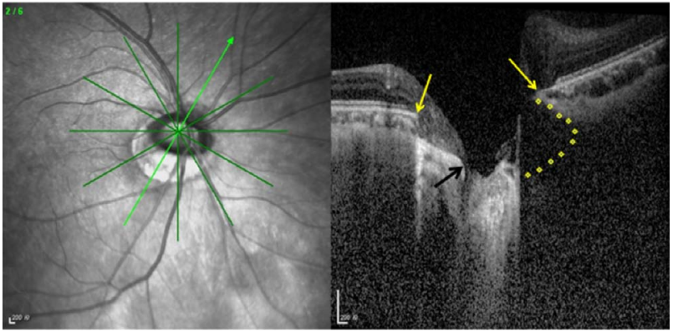
Various limitations in literature!
Jonas JB et al, 2012 & Jonas JB et al., 2013 used sample during the post-mortem and also after enucleation
Jonas JB et al, 2018 used fundus images and NOT OCT
Author recommends SS-OCT for imaging
Dai Y et al, 2013 recommended OCT based imaging with enhanced depth imaging (EDI)
Zhang Q et al, 2019 reported that visualisation of BMO may difficult in OCT
Due to overlaying tissue in some eyes

Slide 10
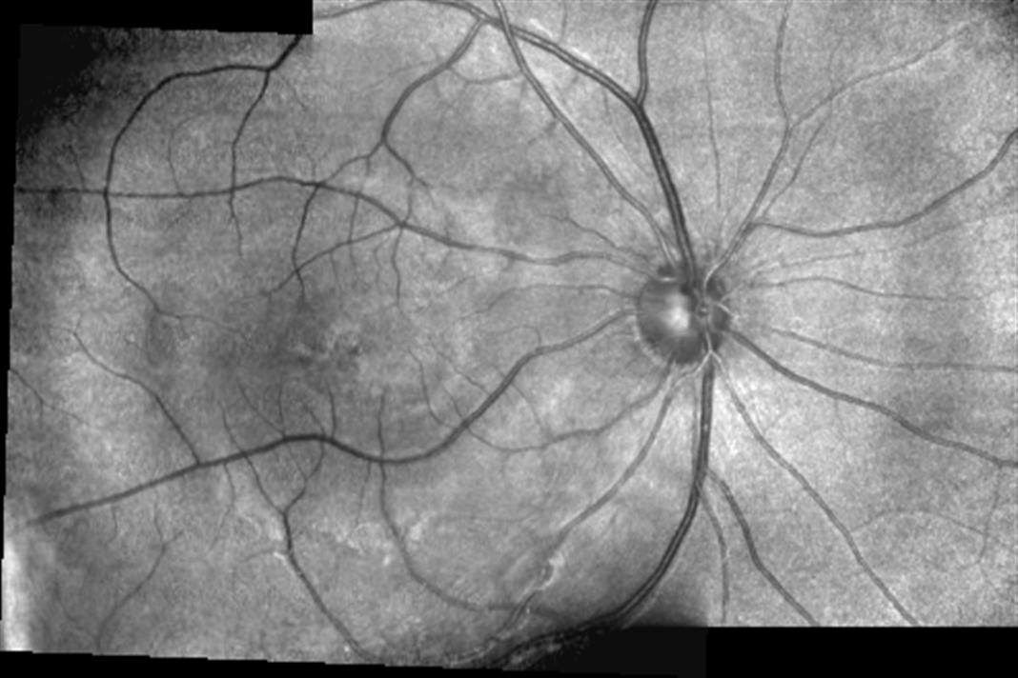
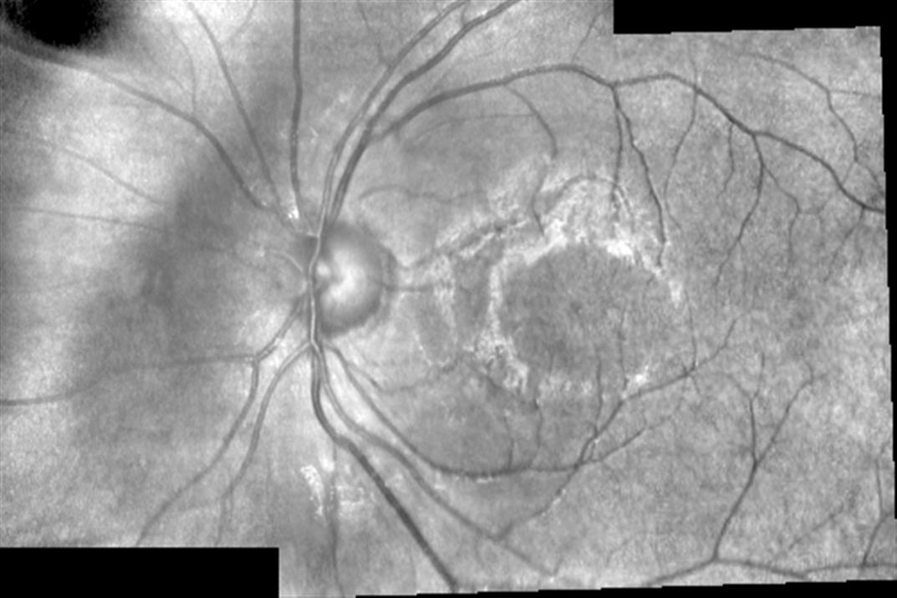

Slide 11
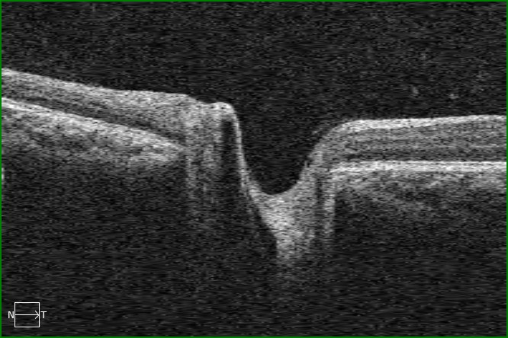
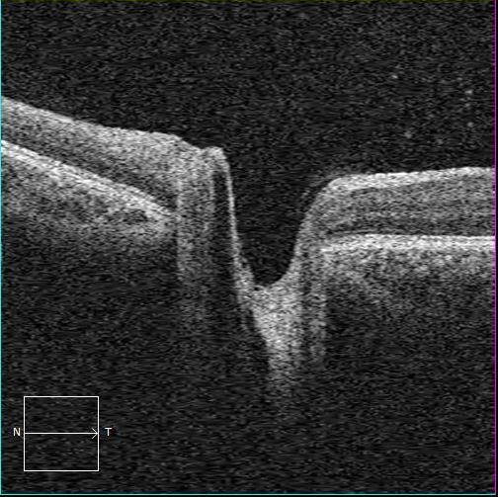
RPE layer
RPE layer

Slide 12
Reference
Guo Y, Liu LJ, Tang P, et al. Parapapillary gamma zone and progression of myopia in school children: The Beijing Children Eye Study. Invest Ophthalmol Vis Sci. 2018;59:1609–1616.
Jonas JB, Jonas SB, Jonas RA, et al. Parapapillary atrophy: histological gamma zone and delta zone. PLoS One. 2012;7:e47237.
Jonas JB, Ohno-Matsui K, Spaide RF, et al. Macular Bruch’s membrane defects and axial length: association with gamma zone and delta zone in peripapillary region. Invest Ophthalmol Vis Sci. 2013;54:1295–1302.
Jonas JB, Fang Y, Weber P, et al. Parapapillary gamma zone and delta zone in high myopia. Retina. 2018;38:931–938.
Guo Y, Liu LJ, Parapapillary gamma zone and progression of myopia in school children: The Beijing Children Eye Study Tang P, et al.. Invest Ophthalmol Vis Sci. 2018;59:1609–1616.
Dai Y, Jonas JB, Huang H, et al. Microstructure of parapapillary atrophy: beta zone and gamma zone. Invest Ophthalmol Vis Sci. 2013;54:2013–2018.
Zhang Q, Xu L, Wei WB, et al. Size and shape of Bruch’s membrane opening in relationship to axial length, gamma zone and macular Bruch’s membrane defects. Invest Ophthalmol Vis Sci. 2019;60:2591–2598

